Slide 1
End-to-End Backend & Smart
Data Extraction & Agent Suite

Slide 2
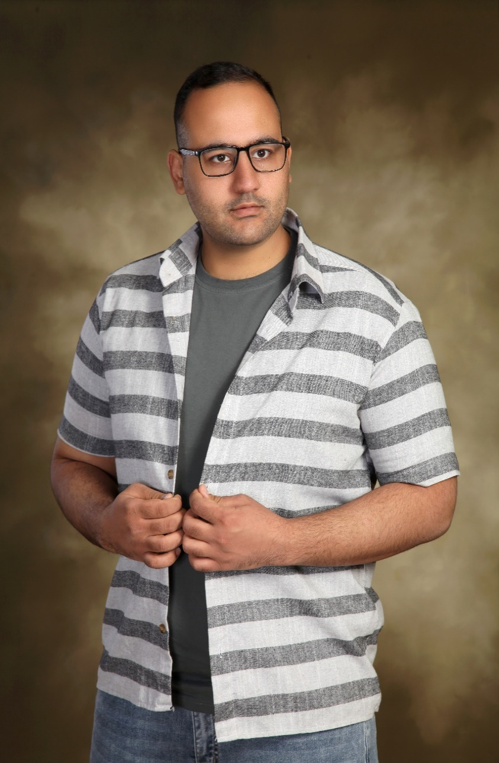

Abuot Me
I’m Saeed Amini, 28 years old, based in London.
For the past six years,
I’ve dedicated myself to programming and continuously
follow global tech trends with passion.
Leveraging my expertise in back-end development,
automated data collection (web scraping),
and AI-driven intelligent systems,
I build innovative and impactful projects that help businesses embrace the digital future.
SaeedAmini
https://github.com/SaeedAmini50

Slide 3
Table of Contents
Introduction
A brief overview of who I am, my background, and passions
Portfolio Highlights
Six selected projects showcasing purpose, technology, and results.
Core Skills
Technical expertise, tools, and development strengths
Work Policy
My collaboration style, project workflow, payment terms, and support commitment
Final Words
A closing message, future goals, and invitation to collaborate

Slide 4

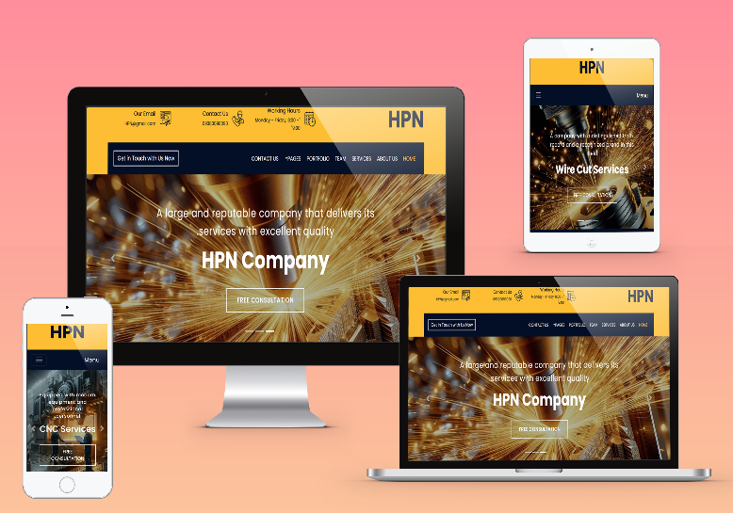

Industrial Website
Client need
SEO
Semantic HTML , optimized URLs , fast Loading & Structured code whit clear comments to boost search engine visibility
User friendly
User – friendly UI and professional branding for improved engagement
Responsive admin panel
Allowing full site customization and multi-site creation
SaeedAmini50/HPN_Idustrial_WebSite
Fully custom industrial website developed for a company in CNC, wire cut, and welding services. Client need: boost brand credibility and attract specialized projects Stack: Django (database, admin panel, backend), HTML, CSS, JS, Bootstrap Timeframe: solo in 2 months Impact: comprehensive service info, SEO-optimized, brought in high-quality projects

Slide 5

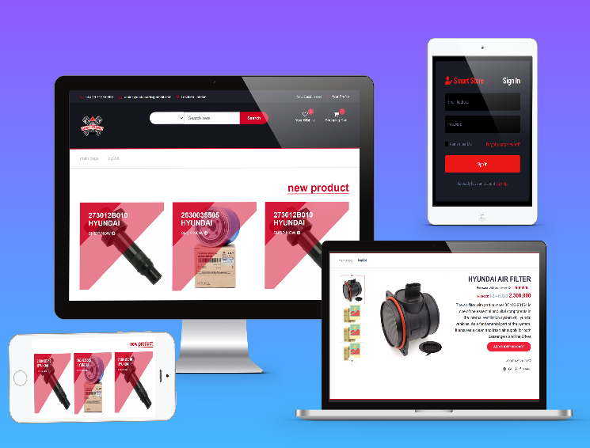

E-Commerce Website
Client need
Secure User
Registration & authentication & Multi-level access control ensures data integrity
Security
Built-in security measures protection against CSRF,XSS,SQL Injection ,and unauthorized access
Online payment
Designed & launched an e-commerce website with an online payment system
SaeedAmini50/hyundai_parts
Developed a fully customized e-commerce platform for an industrial auto parts company. Client need: Seamless and secure management of sales, users, and website operations Stack used: Django (backend, database, admin panel), Bootstrap (frontend) Duration: Completed solo within 2 months Impact: Delivered a scalable, secure system that streamlined sales processes and enhanced user management across the platform

Slide 6
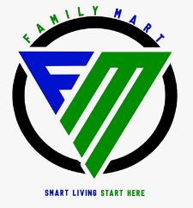

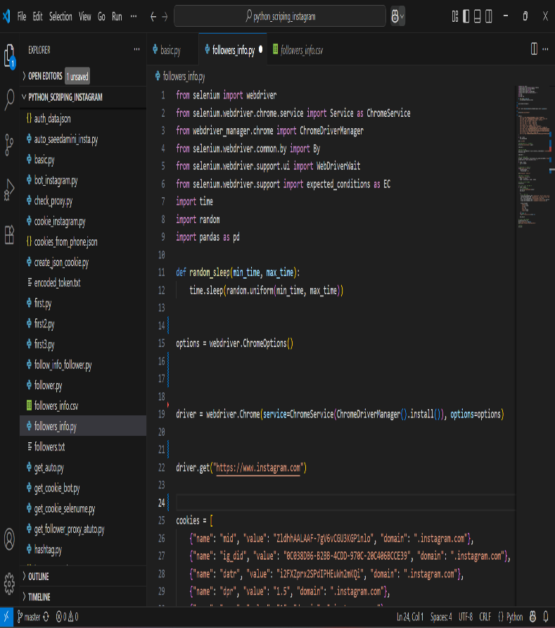
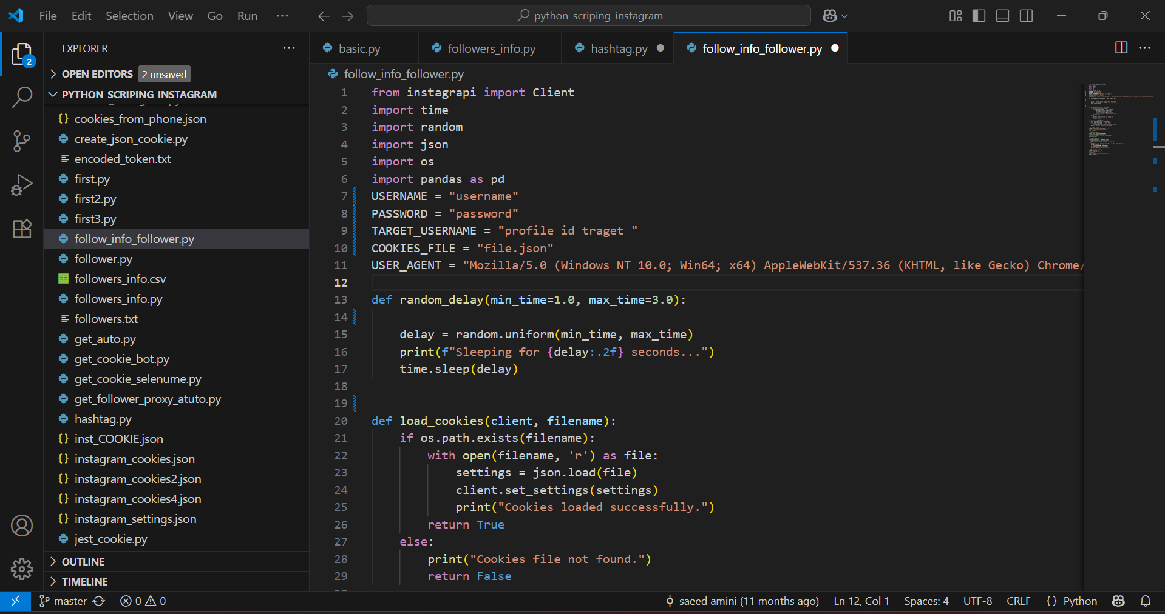
instagram FollowerFetch
SaeedAmini50/python_scriping_instagram
Client need: fast, targeted Instagram follower acquisition
Tools: Instagrapi code(right), Selenium code(left)
Duration: 10 days
Challenge: Instagram’s evolving security measures
Outcome: reliable extraction of follower data and integration into marketing workflows

Slide 7

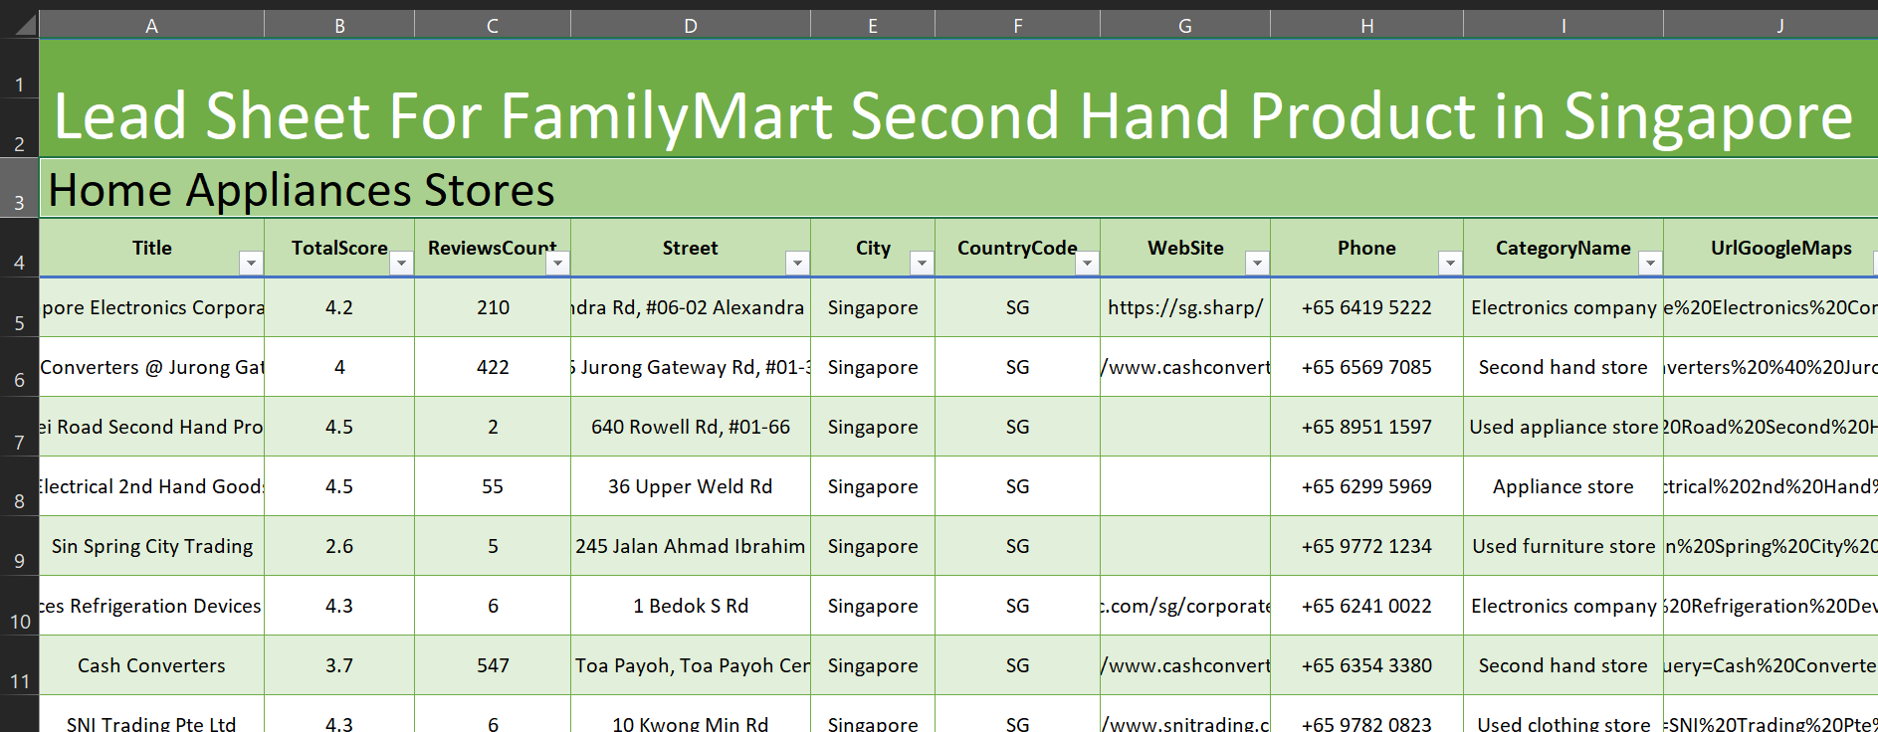
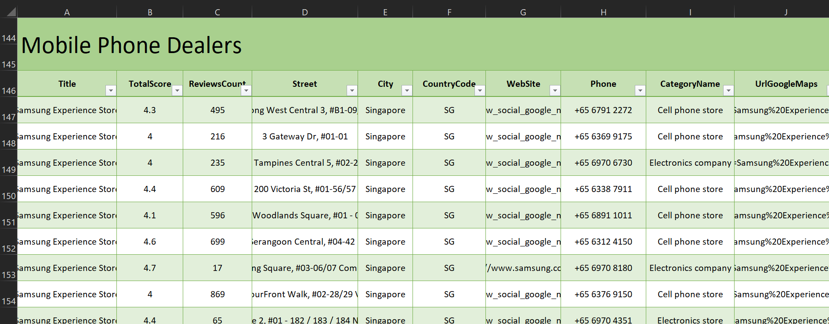
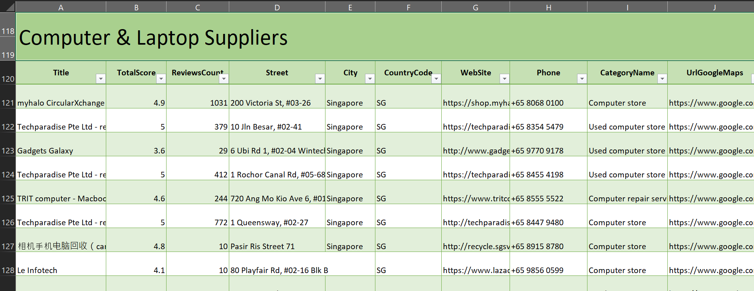
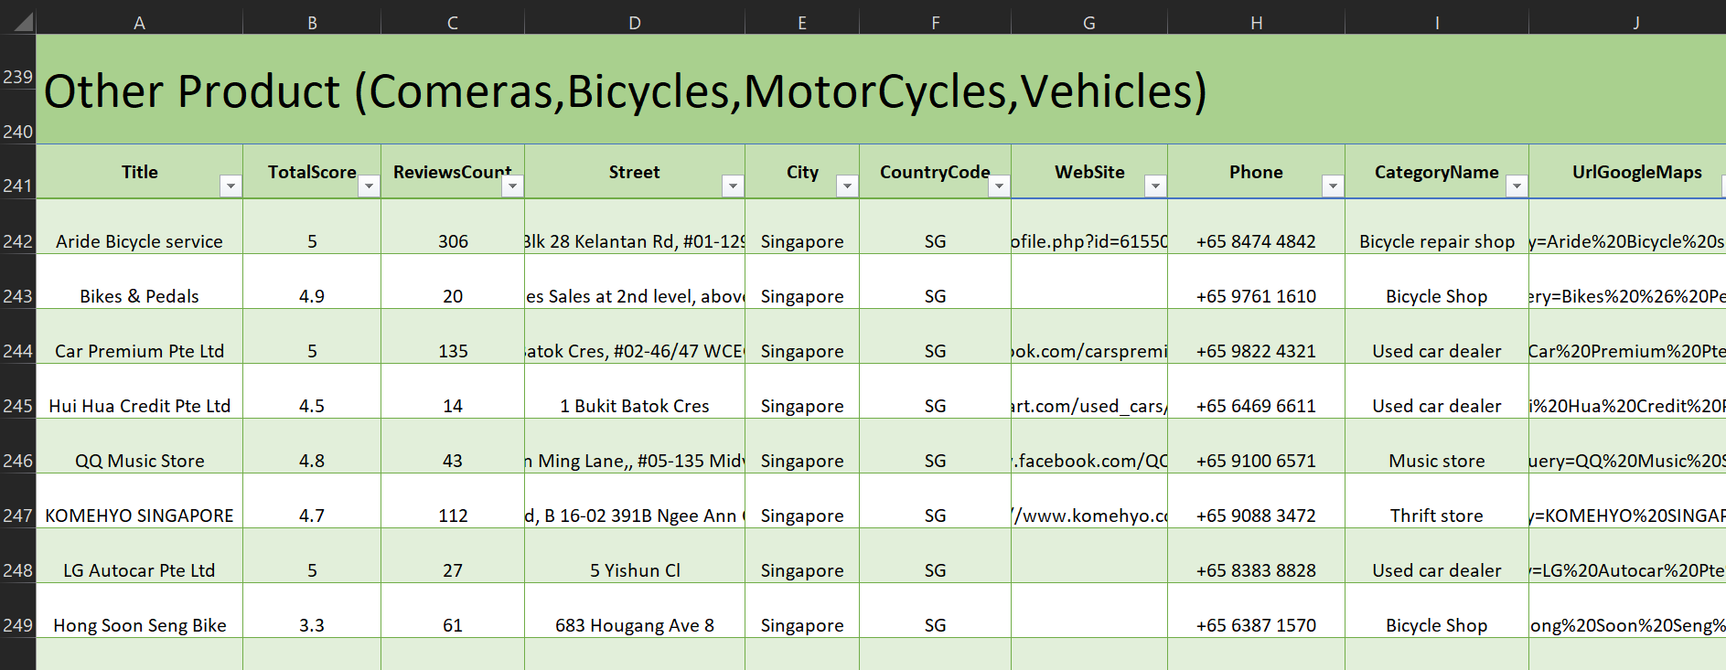
Lead Sheet in Singapore
SaeedAmini50/Lead_Sheets_singapore
Client need: The Family Mart is looking for reliable second hand goods sellers in Singapore to source products
Tools: apify , Excel
Duration: 1 day

Slide 8
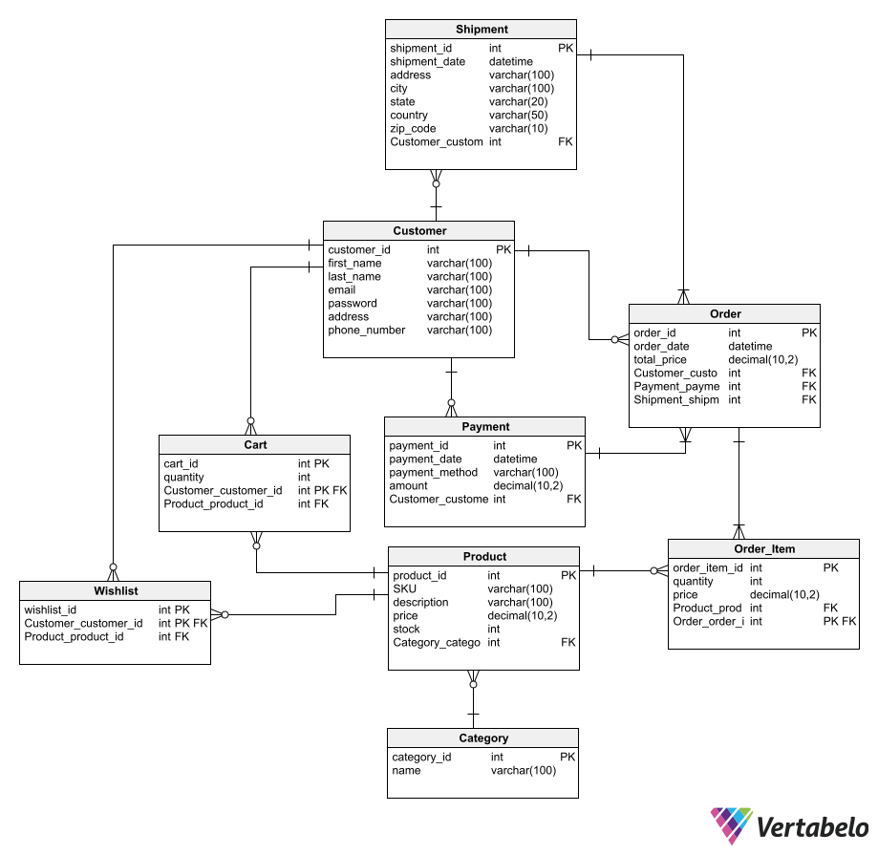
Database developer
For website shopping
This image displays an ER diagram for
buy/sell shops.
I have developed database scripts to construct this database automatically.
Simply copy and paste the provided code into your database the schema will be created
instantly, and sample data will be populated
into all tables.
Ready-to-use code is available for:
Oracle
MySQL
SQLAlchemy
Java (JSP)
SaeedAmini50/database_shopping

Slide 9
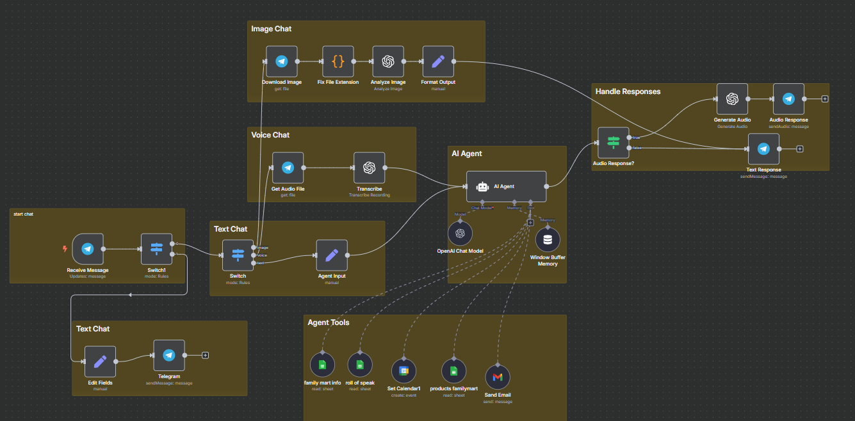


FamilyMart Smart Assistant
Smart Assistant developed for FamilyMart – a home appliance store Implemented across Telegram and WhatsApp
Client need: accurate and timely customer responses
Built with: N8N Duration: 2 days
Outcome: fast, rule-based customer replies and context-aware advertising with telegram
n8n/telegra_familiMart.json at master · SaeedAmini50/n8n
n8n/whatsapp_familymart.json at master · SaeedAmini50/n8n

Slide 10
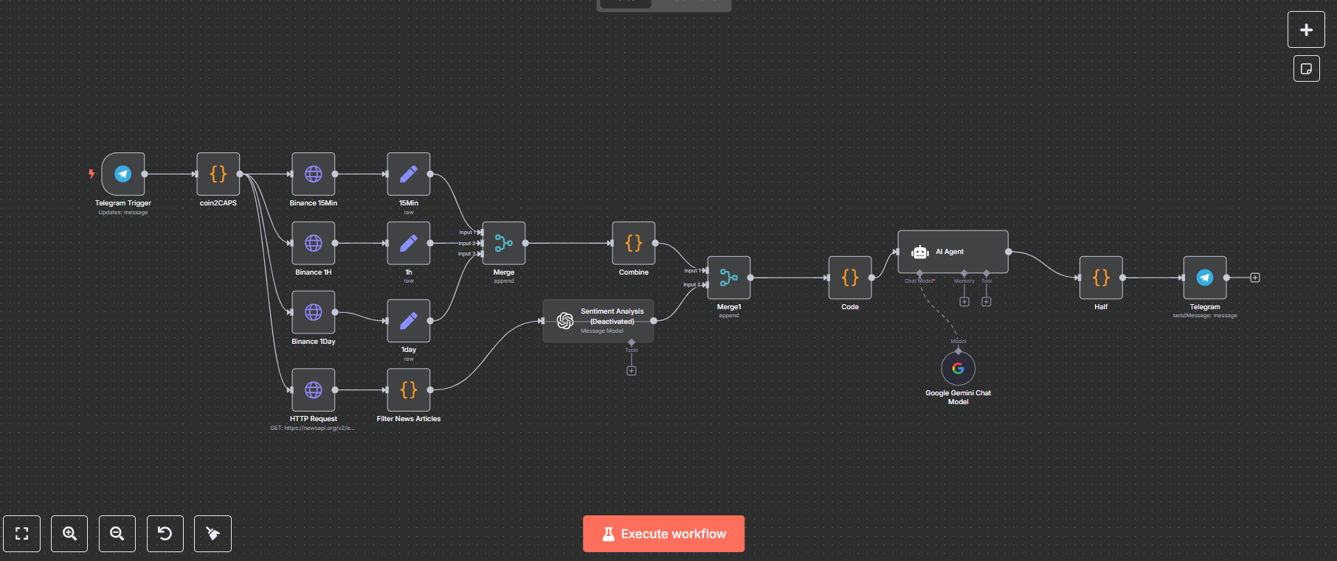


Market Signal Ai
Developed an AI-powered bot for analyzing cryptocurrency trends
Client need: full market insights to make informed entry decisions
Bot features: by entering a coin name, the bot analyzes candlestick patterns,
Google news, and other sources to suggest optimal buy/sell timing
Tools used: built with n8n and custom data analysis modules Duration: completed in 4 days
Impact: enables smart, real-time trading decisions based on live data and intelligent analysis
n8n/skywebs_signal_bot.json at master · SaeedAmini50/n8n

Slide 11
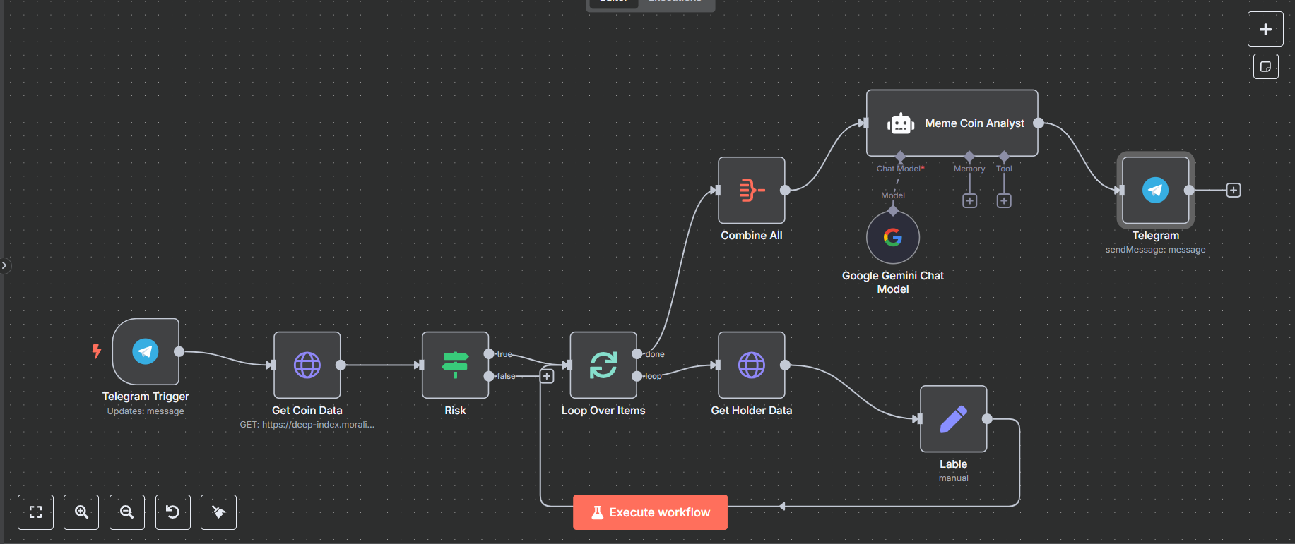
Meme Coin Scan Bot
Project for Sky Web (developing AF Coin)
Client need: real-time tracking of reliable meme coins and recommending top picks per custom criteria
Tools used: n8n Duration: 4 days
Impact: continuous access to trusted token listings and automated top-coin recommendations
n8n/mime coin.json at master · SaeedAmini50/n8n

Slide 12


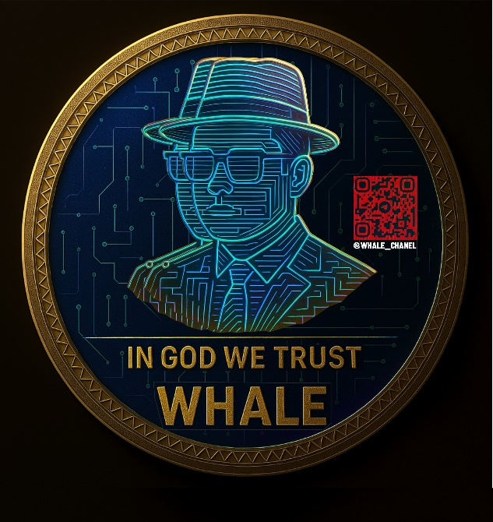


Logo design
For crypo telegram chanel
I created several logo drafts displaying
'whale' for a client to select from.
promising to adjust their chosen design as needed.
The work took 4 days.
SaeedAmini50/logo_crypto_whale

Slide 13
Skills
 | Backend
 | Python Django Flask Api Integration Git & GitHub SQL Alchemy MySQL MongoDB PostgreSQL Oracle (SQL PL/SQL) Algorithms Data Structures
 | WebScraping
 | Scrapy BeautifulSoup Selenium Instagrapi apify Pandas NumPy Automated Data Collection Scrapt Social Media
 | AI & Agent
 | Prompt Writing AI API Ollama N8n Make Zapier Telegram BotAPI Agent Workflow Development
 | Supplementary Skills
 | Web Development (HTML, CSS, JavaScript, Bootstrap, SASS, AJAX, jQuery, Basic TypeScript) Design Tools (Photoshop, Canva, CapCut) Digital Marketing (SEO Website, SEO Social Media, Meta Ads)

Slide 14
🧾 My Work Policy
Collaboration & Communication
Timeline & Delivery
🔹 Clear definition of project scope and expected deliverables at the start
🔹 Consistent communication via Upwork chat
🔹 Weekly progress updates to ensure transparency and alignment
⏳ A detailed timeline for each project phase
⏳ Delivery of a prototype for early feedback
⏳ Final stage includes optimization and bug fixing before hand-off.
Quality Assurance & Support
✅ One month of free post-delivery support to address any issues
✅ Guaranteed performance according to defined specifications
✅ Full confidentiality for all project assets and code
Payment Terms
💳 30% upfront as a project deposit
💳 40% upon delivery of the initial version
💳 30% upon final delivery and project approval

Slide 15
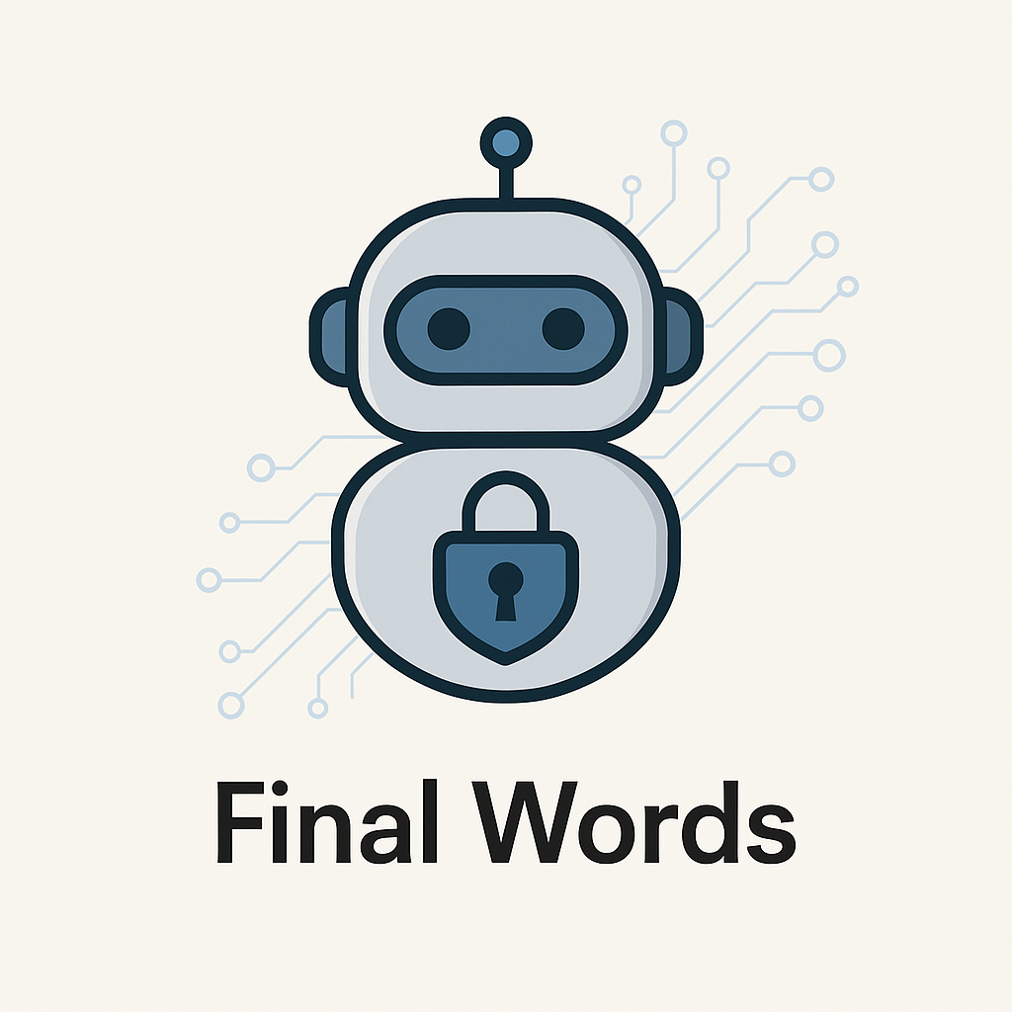
Final Words
I'm not just a developer or designer I'm your Digital Transformation Partner, empowering your business growth through cutting-edge solutions and technical
excellence.
Let’s build together
with precision beyond expectations

Slide 16
Thank you
SaeedAmini50 (SaeedAmini)

